Slide 1
Software Engineering
Project Management

Slide 2
What is a Project?
“Unique process consisting of a set of coordinated and controlled activities with start and finish dates, undertaken to achieve an objective conforming to specific requirements, including constraints of time, cost, quality and resources”
A Project is a planned set of activities
A Project has a scope
A Project has time, cost, quality and resource constraints

Slide 3
What is Project Management?
The art of organising, leading, reporting and completing a project through people
A project is a planned undertaking
A project manager is a person who causes things to happen
Therefore, project management is causing a planned undertaking to happen.

Slide 4
What is Project Management?
Project : A group of milestones or phases, activities or tasks that support an effort to accomplish something
Management : is the process of Planning, Organizing, Controlling and Measuring

Slide 5
Project.
A collection of linked activities, carried out in an organized manner, with a clearly defined START POINT and END POINT to achieve some specific results desired to satisfy the needs of the organization at the current time
Project Management
A dynamic process that utilizes the appropriate resources of the organization in a controlled and structured manner, to achieve some clearly defined objectives identified as needs.
It is always conducted within a defined set of constraints

Slide 6
What does Project Management Entail?
Planning: is the most critical and gets the least amount of our time Beginning with the End in mind-Stephen Covey
Organizing: Orderly fashion (Contingent/Prerequisites)
Controlling: critical if we are to use our limited resources wisely
Measuring: To determine if we accomplished the goal or met the target?

Slide 7
Measuring…….
Are we efficient?
Are we productive?
Are we doing a good job?
What is the outcome?
Is it what we wanted to be?
If you can’t plan it, You can’t do it
If you can’t measure it, you can’t manage it

Slide 8
Project Management
Following are related to Project Management
  Professional Organizations
    Project Management Institute (PMI) (pmi.org)
    Software Engineering Institute (SEI)
    IEEE Software Engineering Group
  Certifications
    PMI’s PMP (Project Management Professional)
  The “PMBOK” – PMI Body of Knowledge
  Tools
    MS Project
    Primavera Project Manager

Slide 9
Project Management
Project Management Skills
  Leadership
  Communications
  Problem Solving
  Negotiating
  Influencing the Organization
  Mentoring
  Process and technical expertise

Slide 10
Project Management Knowledge Areas
PMI has suggested 9 Knowledge Areas
  Project Integration Management
  Project Scope Management
  Project Time Management
  Project Cost Management
  Project Quality Management
  Project Human Resource Management
  Project Communications Management
  Project Risk Management
  Project Procurement Management

Slide 11
Who uses Project Management?
Nearly Everyone to some degree People plan their Days, their Weeks, their Vacations and their Budgets and keep a simple project management form known as ‘’To Do’’ list
Any Process or Means used to track tasks or efforts towards accomplishing a goal could be considered Project Management

Slide 12
Why is Project Management used?
It is necessary to Track or Measure the progress we have achieved towards a Goal we wish to accomplish
We use Project Management to Aid us in Maximizing and Optimizing our resources to accomplish our goals

Slide 13
How much time does Project Management take?
Not much. Probably more time is wasted as a consequence of lack of Project Management tool than is spent to Plan adequately, Organize, Control effectively and Measure appropriately
How long: As long as there are things to do

Slide 14
Why is Project Management Important?
Enables us to map out a course of action or work plan
Helps us to think systematically and thoroughly
Unique Task
Specific Objective
Variety of Resources
Time bound

Slide 15
Advantages
In built Monitoring/ Sequencing
Easy and Early identification of Bottlenecks
Activity based costing
Identification and Addition of missing and new activities
Preempting unnecessary activity/expenditure
Timely Completion
Assigning tasks
Reporting

Slide 16
Effective SW project management focuses on 3 P’s:
people
problem
process

Slide 17
1. People
must be organized into effective teams
motivated to do high-quality work
coordinated to achieve effective communication and results

Slide 18
2. Problem
must be communicated from customer to developer
decomposed into its parts
positioned for work by SW team

Slide 19
3. Process
must be adapted to the people and problem
to get the SW developed:
common process framework is selected
appropriate SWE paradigm is applied
set of work tasks chosen

Slide 20
Road to Better Project Management
Find a Project plan that fits your style of project management needs
It may be as simple as creating templates, forms and spreadsheets to track tasks
Formation of a Project Management committee
Listing out all the tasks and sub-tasks to accomplish a goal
Jot down the time period and person responsible against each task/sub-task

Slide 21
Road to Better Project Management
Identify a Project Manager
Identify Task Managers
Sequence the activities in relation to time period
Present to the PMC
Finalize by reaching an agreement and start work.

Slide 22
Implementation
Regular Monitoring
Resource Support
Critical issues discussed and solution
Meeting with the team on completion of each major milestone
Track the progress against the plan
System to add/delete tasks in the PMT

Slide 23
Consequences of not using PMT
    DELAY
    COST
    WASTE OF RESOURCES
    QUALITY
    DISSATISFACTION
    REPUTATION

Slide 24

Project Manager Role
A Good Project Manager
  Takes ownership of the whole project
  Is proactive not reactive
  Adequately plans the project
  Is Authoritative (NOT Authoritarian)
  Is Decisive
  Is a Good Communicator
  Manages by data and facts not uniformed optimism
  Leads by example
  Has sound Judgement
  Is a Motivator
  Is Diplomatic
  Can Delegate

Slide 25

Stakeholder
“A person or group of people who have a vested interest in the success of an organization and the environment in which the organization operates”

Slide 26
Stakeholders
Sponsor
Funding Body
Customer
Suppliers
End User
HSE/Environmental Agency
Maintenance Team
Neighbours/Community/Shareholders
Fusion Community
Interfaces

Slide 27
Stakeholder Engagement process
Identify Stakeholders
Assess needs
Define actions
Establish communication channels
Gather feedback
Monitor and review

Slide 28
Key Points in Project Set-up and Definition
Create Project Management Plan (PMP)
Be clear of scope and objectives
Establish clear statement of what is to be done (WBS)
Establish Risks to be Managed
Establish Costs and Durations
Establish Resources Required

Slide 29
Project management Plan - PMP
Master Document for Project
Defines the following:-
  Project Objectives, Scope, Deliverables
  Stakeholders (Internal & External)
  Work to be done (WBS)
  Project Organisation and Resources (OBS)
  Project Costings (CBS)
  Project Schedule
  Procurement/Contract Strategy
  Risk Management
  Quality management
  Change Management

Slide 30

Project Planning

Slide 31


Project Planning
Adequate planning leads to the correct completion of work

Slide 32

Planning
Inadequate planning leads to frustration towards the end of the project & poor project performance
Project Start
Project End

Slide 33
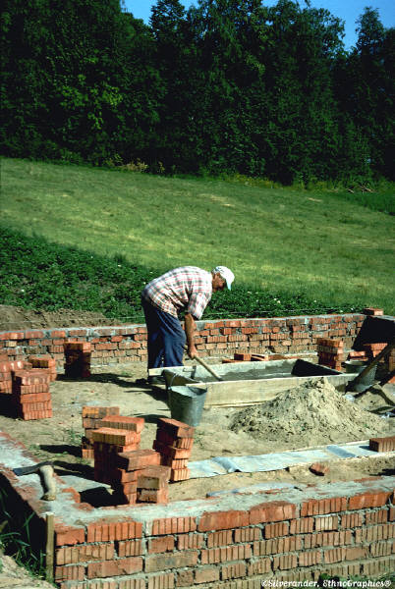
Work Breakdown Structure (WBS)
The Work Breakdown Structure is the foundation for effective project planning, costing and management.
It is the most important aspect in setting-up a Project
It is the foundation on which everything else builds

Slide 34
Work Breakdown Structure - Definition
“A Work Breakdown Structure (WBS) is a hierarchical (from general to specific) tree structure of deliverables and tasks that need to be performed to complete a project.”

Slide 35

Project Risk Management

Slide 36
Project Risk – Definition (1)
“Project risk is an uncertain event or condition that, if it occurs, has a positive or negative effect on a project objective”

Slide 37
Project Risk – Definition (2)
“A combination of the probability of a defined threat or opportunity (Likelihood) and the magnitude of the consequences of the occurrence (Impact) defines a Risk Index”

Slide 38
Risk Impact
Threat → Scope → Poor Quality Product
Threat → Schedule → Late Delivery
Threat → Cost → Overspend
In addition there are health, safety and environmental threats that must be managed (CDM Regulations)

Slide 39
Risk Management Process
Identify Risks
Assess likelihood and impact
Rank risks and prioritise
Define risk management approach & actions
Implement actions
Monitor & review

Slide 40
Risk Management…….
Risk = some adverse circumstance that may happen and affect negatively the project, the product, and/or the business
Categories of risk:
  Project risks
  Product risks
  Business risks
Risk management means anticipating risks and preparing plans to reduce their effect

Slide 41
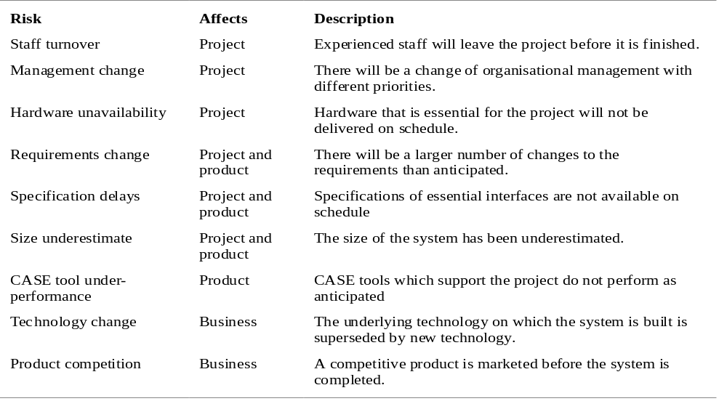
.Risk Management……
Examples of risks in the software process [Fig. 5.9, SE-8]

Slide 42
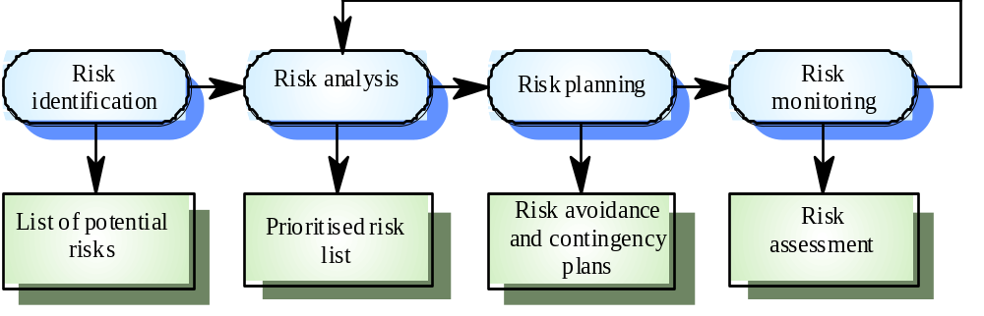
..Risk Management…..
The risk management activities [Fig. 5.10, SE-8]

Slide 43
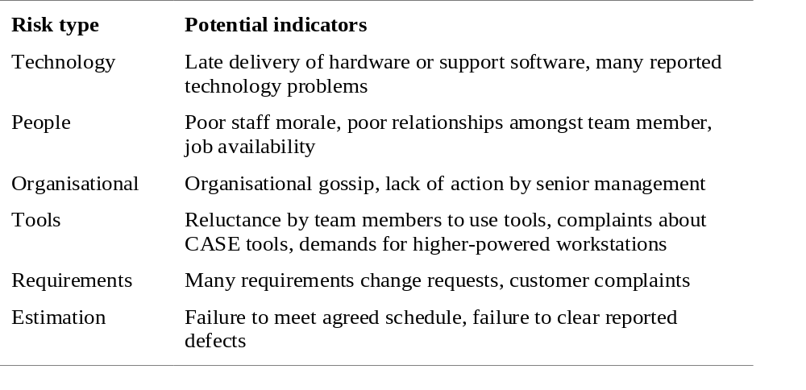
…Risk Management….
Types of risk in risk identification [Fig. 5.11, SE-8]

Slide 44
Risk Management…
Risk analysis:
  Estimate risk probability:
    Very low (< 10%)
    Low (10-25%)
    Moderate (25-50%)
    High (50-75%)
    Very high (> 75%)
  Establish risk seriousness:
    Insignificant
    Tolerable
    Serious
    Catastrophic

Slide 45
Risk Management..
Risk planning means preparing a strategy to deal with each of the risks identified
Classes of strategies:
  Avoidance strategies: the probability of the risk will be diminished
  Minimization strategies: the effect of the risk will be reduced
  Contingency strategies: plans for the worst case scenarios

Slide 46
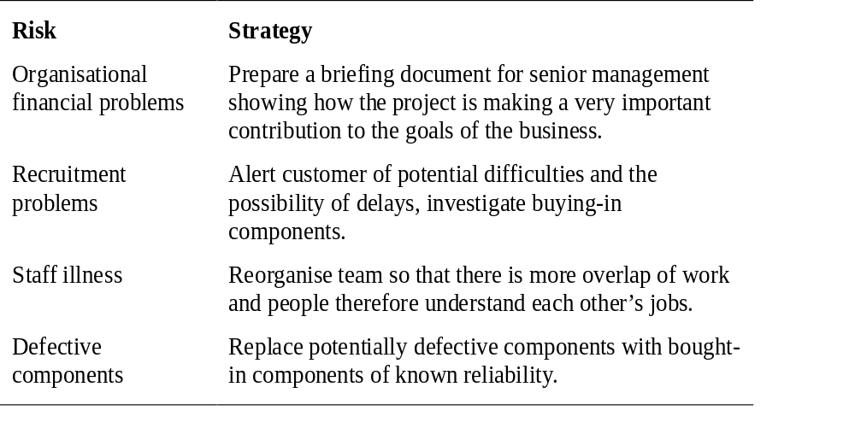
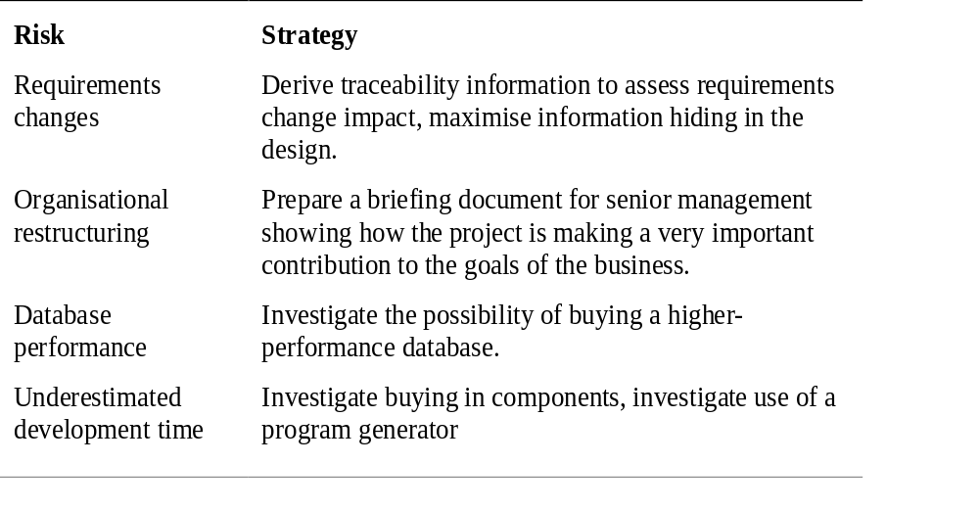
Risk Management.
Examples of risk management strategies [Fig. 5.13, SE-8]

Slide 47
…….Risk Management
Risk monitoring:
  Frequently re-assess the risks
    Changes in risk probability?
    Changes in risk gravity?
  Take into consideration risk factors
  Discuss key risks at each management project progress meeting

Slide 48

Project Management….
Work Smart Not Hard !!!

